Slide 1
Company Presentation

Slide 2
Company
Technology
Quality & Service
Customers

Slide 3
Company Overview
Leading provider of 1st rate value-added services and mobile device management solutions
Established in 1999 as Telecom Division of One1 Group
Over $300M annual sales (2014)
Public company, traded in the Tel-Aviv Stock Exchange (TASE: ONE)
WORLDWIDE customer base – Fixed, mobile, VoIP telecom operators, MVNE's and MVNO's, telecom providers
5 Key strategic partners: Microsoft, Red Bend, HP, Dialogic, MIND
3,100 IT & Telecom experts
One1 Telecom Division

Slide 4
Mission Statement
To become your trusted partner for reliable, interoperable, future-proof innovative Value Added Services and Mobile Device Management Solutions. To provide telecom operators with tools for rapid adjustment to market trends, secure and generate revenues, and increase customer loyalty by providing true value.
One1 Telecom Division

Slide 5
Company
Technology
Quality & Service
Case Studies

Slide 6
Varied, Innovative Portfolio
Our Platform
Value Added Services and Mobile Device Management solutions over a single platform.
Offers high modularity and scalability, for easy integration into any network topography.
Can run on Linux or Windows OS and can be installed in the Cloud, on a virtual Machine or on-premises.
CanVAS
Rich customer experiences and value added services over the Cloud to monetize your network assets.
MDM+
A single touchpoint for all your Device and SIM Management needs, giving you an edge, and streamlining your operations.
Innovation LAB
Groundbreaking technology tailored to customer requests, bringing new value to carriers.

Slide 7
Competitive Edge
Game-changing patents - Femtocell replacement and smart Wi-fi calling - lift ARPU
High-end tailor made applets for MDM products: Maximum flexibility at competitive prices
Central, modular management software for VAS products
Long-standing company with a rare combination of strengths:
In-depth knowledge of cellular operator switches
Expertise in apps for SIM
Expertise in apps for Android/iPhone

Slide 8
CanVAS - Cloud-Based Value Added Services
MMSC | SMSC | IVR | Visual Voice Mail | Voicemail
Complete solution for mobile multimedia messaging services | High capacity traffic and constant premium quality solution | Easy creation of a variety of network services | Enhanced with a messaging-oriented environment | Feature rich solution
USSD GW | MTG | WAP GW | PRBT | BMS
Supports interactive communication between users and applications | Powerful general-purpose, standalone Multimedia Transcoding server | Offers subscribers access to mobile and web services using mobile terminals | Personal Ring Back Tone for advanced personalization | Manages bulk multimedia messaging services

Slide 9
MDM+ - Touchpoint for SIM & Device Management
OTAF | SIM OTA | Device Management
Advanced Service Provisioning and Parameter Activation system for CDMA network | Enables remote over-the-air management of files and applets on the SIMs within a network. | Proactively and remotely supports subscribers throughout entire device lifecycle

Slide 10
Innovation LAB – The Future of Telecom
Roam Home SMS | Wi-Fi Calling | Smart-FI | Hybrid Steering of Roaming
Allows operators to cut expenses on national and international roaming SMS | Performs voice intercepting | Enables carriers to sell Wi-Fi data | Manages roaming allocations according to business needs
Mobile Marketing | CanVas SCE | USSD Callback | Roam Home Callback
Manages VASP's and bulk multimedia messaging services | Web based GUI system for creating VAS applications | Helps operators retain income from roaming calls, while offering a seamless user experience | Seamless low-cost complementary roaming service, offering a standard call experience.

Slide 11
Company
Technology
Quality & Service
Customers

Slide 12
Telecom Grade
RELIABILITY & PERFORMANCE
99.999% availability, no single point of failure
Outstanding KPI’s - Up to 10M BHSM, TPS/server ratio, Time-to-Send, success send rates, billing integrity rate
FULL REDUNDANCY
All hardware & software components are redundant on module, server, site and geographical levels
HIGH AVAILABILITY & SCALABILITY
Can begin with low capacity and grow on demand
Active-Active load balanced architecture allows seamless scalability with zero maintenance down-time
REMOTE DEPLOYMENT & MAINTENANCE
SECURITY

Slide 13
Support & Professional Services
VIP Support by HP - one day response anywhere in the world.
24 X 7 X 365 support with offices worldwide
Access to developers when required
Training courses- maximum knowledge transfer
Unified software, Unbeatable Time to Market
Advanced CRM & Helpdesk:
Web access,
Ticket opening & Monitoring,
Direct access

Slide 14
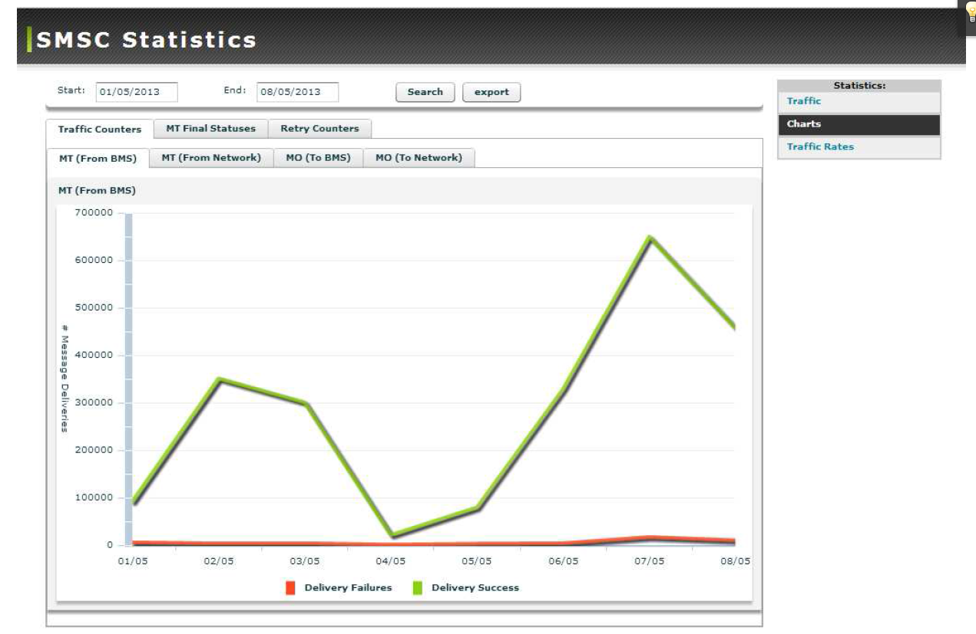
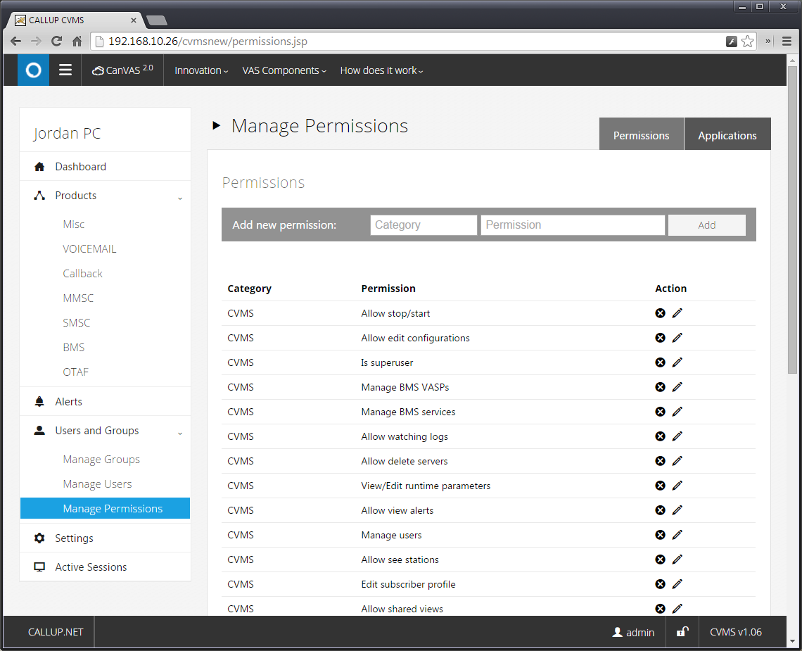
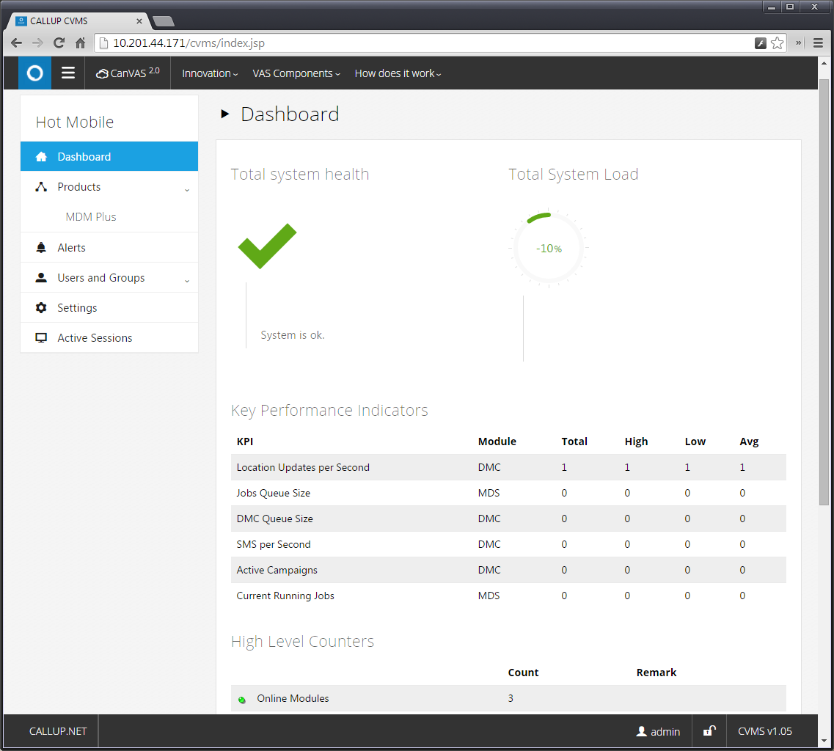
Unified, Versatile Management System
UNIFIED MANAGEMENT
CARRIER GRADE
WEB INTERFACE
MULTI HIERARCHY

Slide 15
Company
Technology
Quality & Service
Customers

Slide 16
Leading Customers

Slide 17
Select Customers
CUSTOMER | COUNTRY | SIZE | PRODUCTS
EUROPEAN CARRIER | --- | 11M+ | MDM+
LATAM CARRIER * | Chile | 5M | MDM+
IUSACELL | Mexico | 16M | MDM+ (Voicemail, WHC/NFM, SMSC, MDM+)
HOT MOBILE | Israel | 1M | MDM+ (BMS, SMSC, USSD,MDM+)
MAKEDONSKI TELEKOM | Macedonia | 0.5M | CanVAS (Voicemail) for fixed network
MTS | India | 20M | MDM+
EFFORTEL | Belgium, France, Italy, Taiwan | 1M | CanVAS (Voicemail, WHC/NFM)
PELEPHONE | Israel | 3M | MDM+ (MMSC, BMS, MDM+)
CELLCOM | Israel | 3M | CanVAS (MMSC, BMS)
MTN | Nigeria | 20M | USSD Callback
KYIVSTAR | Ukraine | 25M | IVR + Songmatcher
ORANGE | Dominican Republic | 0.5M | MDM+ (MMSC, MDM+, SMSC)
GOLAN TELECOM | Israel | 0.5M | CanVAS (SMSC, MMSC, Voicemail, WHC/NFM, BMS)
YOUPHONE | Israel | 100K | MDM+ (SMSC, MDM+)
* In process

Slide 18
Case Studies
Mexico's 3rd largest wireless telecommunications operator.
Over 10 million subscribers (67% prepaid)
CallUp’s Advanced Voicemail
Solution
Large device management and voicemail system, distributed over 12 sites
Including MDM+,IVR, SIP, DB, CVMS
On-site maintenance and support
Israel’s 4th largest MNO.
~1 million subscribers, with various card manufacturers and a complex environment.
Custom Tailored Fast Delivery
System delivered in a few months with all adaptations.
All interfaces maintained.
Gemalto DB kept updated in parallel (forking)
4G-card ready
Steering (Full+MI)
Indian CDMA operator, 10-15M subscribers
Unique Over the Air Solution
OTAF solution, based on Over-the-Air Service Provisioning for activation of devices over the air, Over-the-Air-Parameter Administration for updating parameters in devices over the air, *228 and IVR.

Slide 19
What Our Customers Say
"CALLUP’s SIM OTA will allow us to manage the SIM cards with maximum efficiency, improving customer service and saving considerable costs and time, while interfacing with various functions related to our extensive mobile activity. Following our successful experience with CALLUP’s BMS platform, we decided to choose CALLUP for SIM management as well.”
“There is no doubt that CallUp Net’s over-the-air Mobile Device Management solution has been and continues to be a part of Pelephone's strategic platforms. CallUp Net’s Mobile Device Management solution enables Pelephone to provide uncompromising and intuitive user experience while cutting operational costs”.
Ilan Alter
Director, Cellular Applications - Engineering Division
Avi Benguigui
Vice President Engineering
"The implementation of CALLUP SIM OTA enables YouPhone to easily manage the lifecycle of the SIM cards installed in our subscribers handsets, serving our clients in a more consumer-friendly manner. SIM OTA helps YouPhone save costs, and enhance its customer service and satisfaction.“
“CALLUP NET proved to be a great choice for supporting both our new LTE network and existing CDMA network with a single device and SIM management platform. Moreover, CALLUP demonstrated technical expertise in precisely defining the services and in meeting our highly challenging project timelines. They are truly a partner to rely on.”
Ariel Schreiber CEO
Santiago Peralta
CTO.

Slide 20
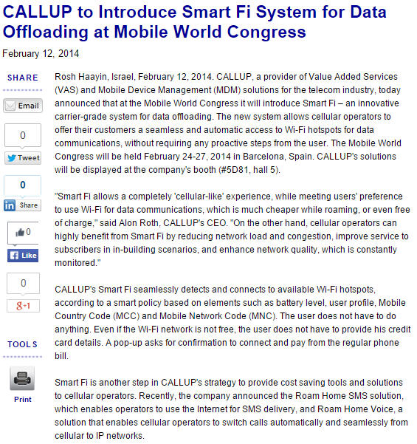
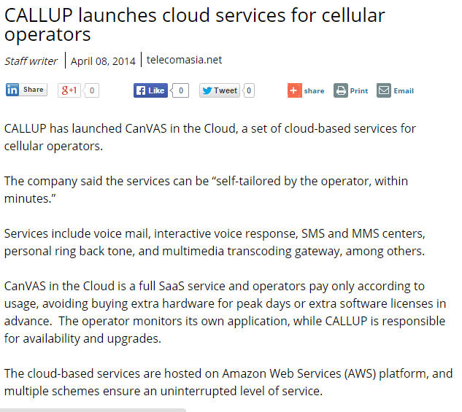
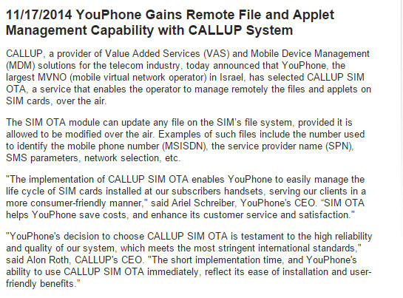
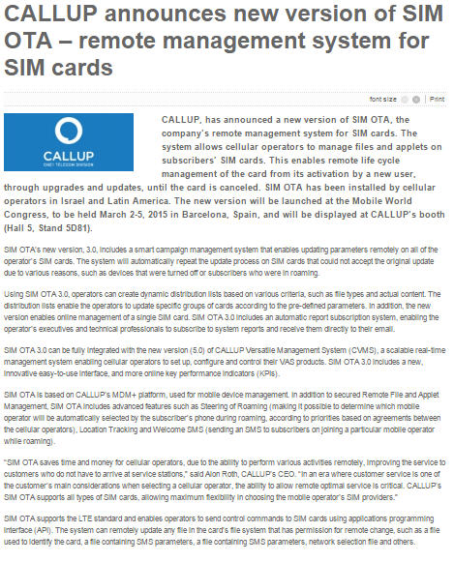
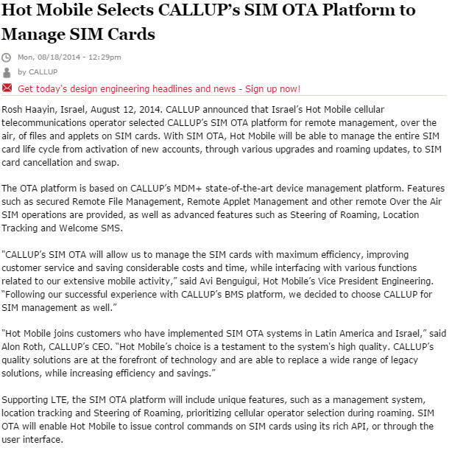
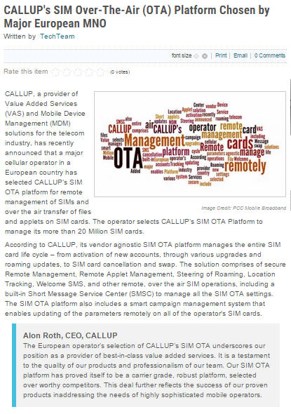
In the Press

Slide 21
Thank You
All rights reserved Callup © 2013 | www.callup.net | Facebook | Twitter | Linkedin

