Slide 1
MDM+

Slide 2
Platform Overview
Tech Info
Timeline
Customers

Slide 3
Overview
ACTIVE CUSTOMER MANAGEMENT
A SINGLE TOUCHPOINT FOR ALL YOUR DEVICE AND SIM MANAGEMENT NEEDS, GIVING YOU THE EDGE, STREAMLINING YOUR OPERATIONS
AND GETTING READY FOR THE FUTURE
OTAF | SIM OTA | Device Management
Advanced Service Provisioning and Parameter Activation system for CDMA network | Enables remote over-the-air management of files and applets on the SIMs within a network. | Proactively and remotely supports subscribers throughout entire device lifecycle

Slide 4
The Challenge & Solution
THE CHALLENGE
As networks evolve, streamlining operations becomes critical for minimizing investments in CAPEX and OPEX.
THE SOLUTION
Keep devices up-to-date and provide Value Added Services to:
Drive up revenues
Ensure positive customer experience
Increase customer loyalty
All this while supporting both legacy and broadband networks.

Slide 5
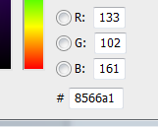
Key Features
One platform for all standards:
LTE
GSM/UMTS
CDMA
Multiple use cases:
Device Management, GSM/UMTS device life cycle management
Automatic Device Detection (ADD) and Configuration (ADC)
OTA device settings (APN/Browsing/MMS/etc.)
FOTA, SCoMo, and other OMA DM services

Slide 6
The Platform
TELCO GRADE
INSTALLATION
Installed at the service provider’s network
INTEGRATION
Full integration with SMSC using SMPP protocol
SMSC
CallUp SMSC – dedicated SMSC for OTA – optional
Deployed on Linux or Windows Server platforms
Oracle/MySQL RDBMS
Scalable: 2->30 machines
High availability
No single point of failure
Redundancy: N+1
SNMP compliant

Slide 7
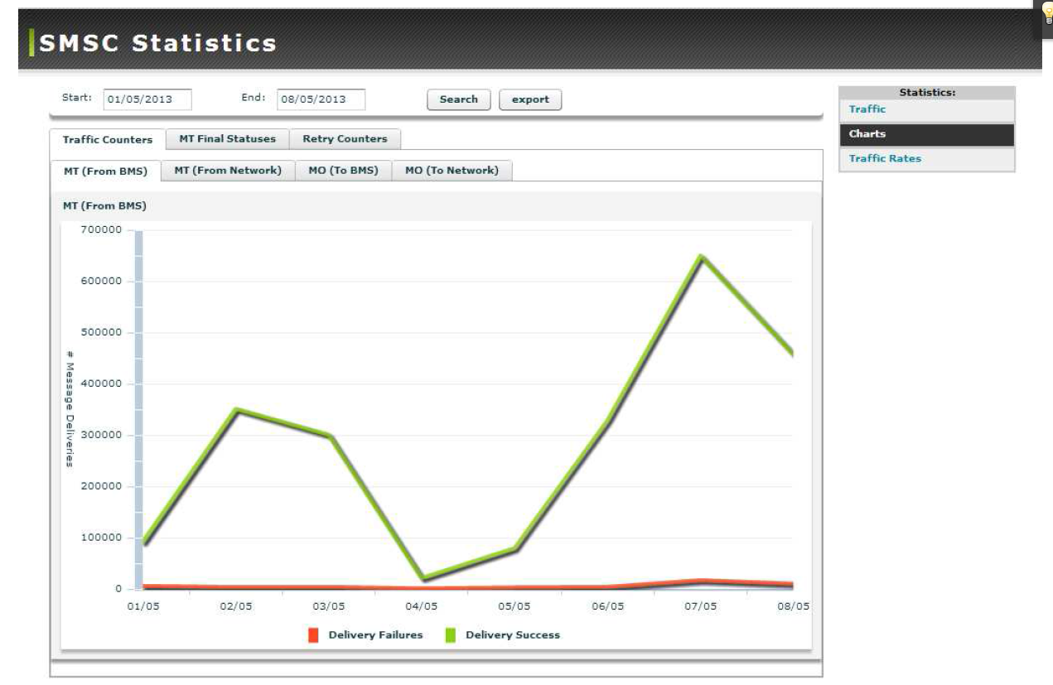
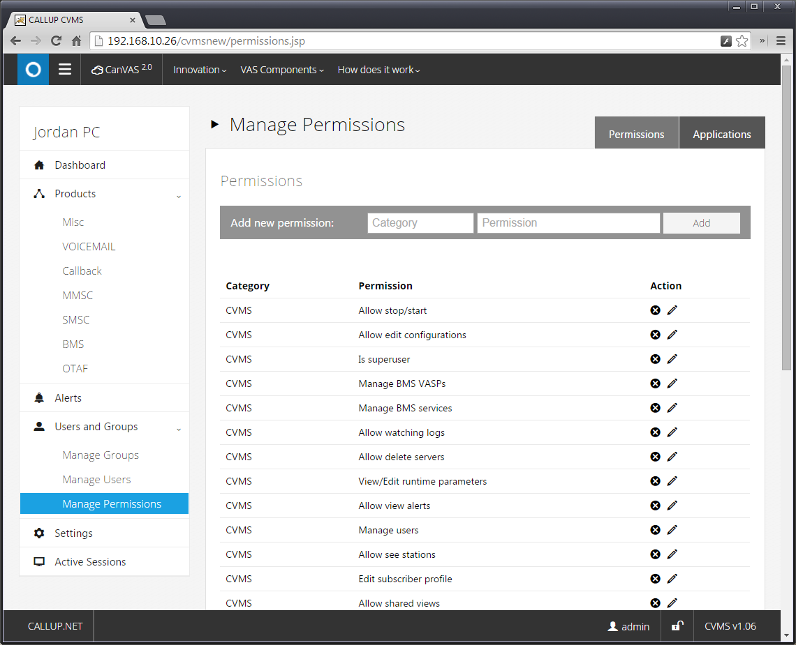
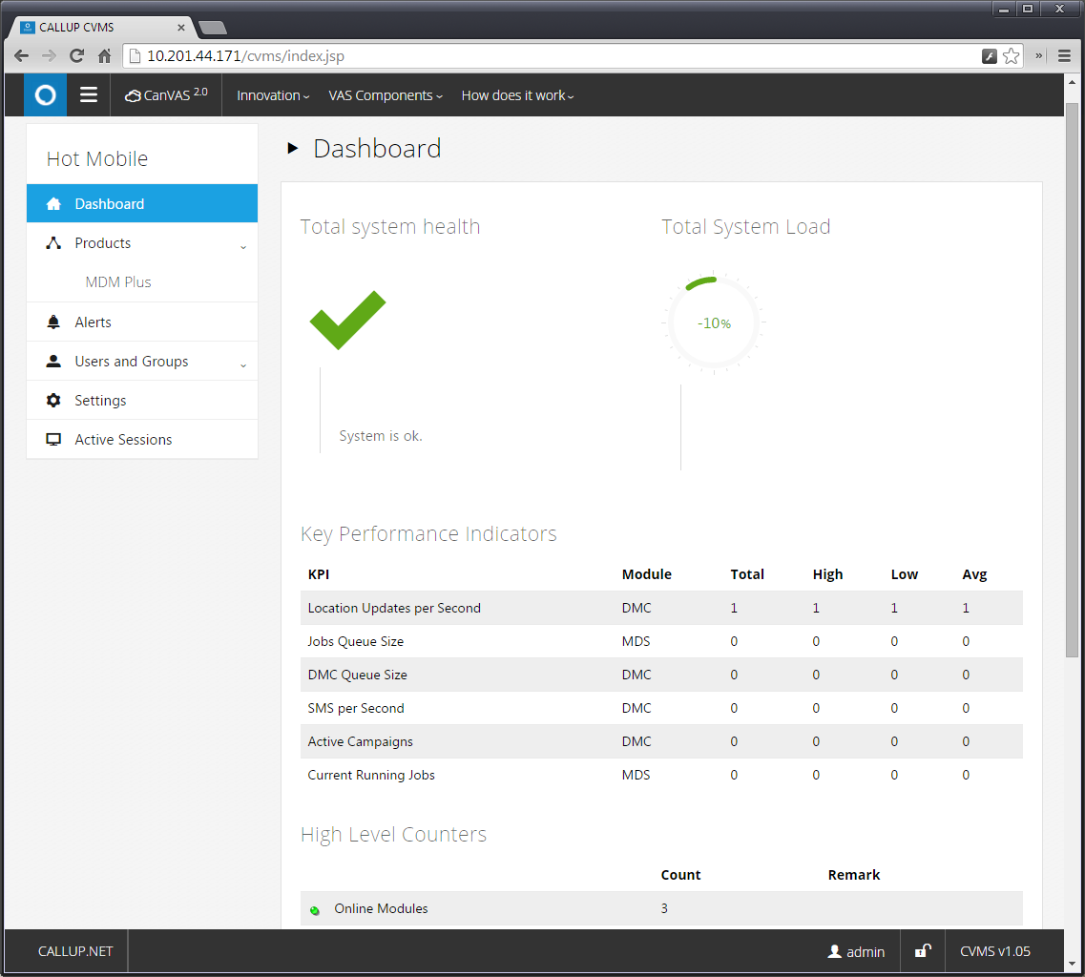
Unified, Versatile Management System
UNIFIED MANAGEMENT
CARRIER GRADE
WEB INTERFACE
MULTI HIERARCHY

Slide 8
Device Management – Key Features
ADD (Automatic Device Detection)
HLR based triggers
Log parsing
Virtual EIR or Full EIR
ADC (Automatic Device Configuration)
Supports all OTA settings technologies
Customized device profiles
Supports settings for APN, browsing, MMS, smartphones, SIP, WiFi, Email etc.
Device Profiles Database
Regular biweekly update service
Huge TAC database constantly updating
Full OMA DM Server, including Support for Common Management Objects
Including FOTA, ScoMO, Lock and Wipe etc.
One1 Telecom Division

Slide 9
SIM OTA – Key Features
SIM Remote File Management, SIM Remote Applet Management
SIM file reflection, scenarios composition
Field proven LTE support for 4G cards
Dynamic distribution lists (Targets), including current file value criteria
Profile management, support for all SIM card vendors
Web service APIs for all functionality
OTA over SMS and IP (4G HTTPS/PSK)
CDR records, Audit logs, reports, OTA dashboard, inherent backup/restore
One1 Telecom Division

Slide 10
SIM OTAF – Key Features
OTASP (Over the Air Service Provisioning)
Supports the *228/*229 IVR portal, allowing new phones to be activated and provisioned in the operator’s network.
OTAPA (Over the Air Parameter Administration)
Number Assignment Module (NAM) programming (download and uploaded)
A Key generation for session authentication
Preferred Roaming List (PRL) download and upload.
3G Packet Data (3GPD) operational parameters
Preferred User Zone List (PUZL)
OTAF supports true ESN, Pseudo ESN and MEID.
Includes web interface for administrators and customer support representatives, for OTAPA actions.
Complete API for integration with 3rd party systems.
One1 Telecom Division

Slide 11
Support and Professional Services
VIP Support by HP – 24 x 7 response anywhere in the world.
24 X 7 X 365 support with offices worldwide
Access to developers when required
Training courses- maximum knowledge transfer
Unified software, Unbeatable Time to Market
Advanced CRM & Helpdesk:
Web access,
Ticket opening & Monitoring,
Direct access

Slide 12
Platform Overview
Tech Info
Timeline
Customers

Slide 13
Functionalities & System Interfaces
Automatic Device Detection and Configuration (OMA CP, OMA DM)
FOTA - Firmware Updates
Software & Application Management
Inventory Management
Diagnostics & Monitoring
Lock & Wipe ,SIM OTA Parameter Administration
Service (Provisioning and Activation (CDM)
Extensive Device Repository
Equipment Identity Registry
Logs & Reports
Scheduler & Campaign Manager
Multi Tenancy & Enterprise
Profile Support
API’s
Configurable Rules Engine including
Location Based rules
FUNCTIONALITIES
SYSTEM INTERFACES

Slide 14
Architecture

Slide 15
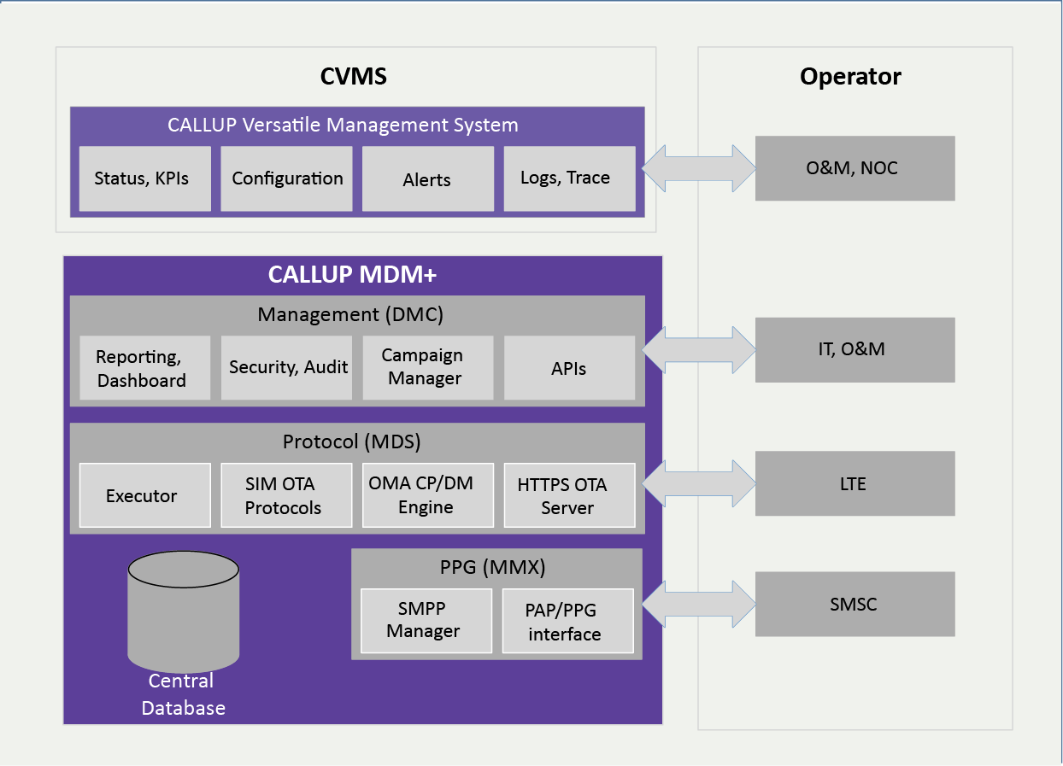
SIM OTA - Block Diagram

Slide 16
SIM OTA – LTE Support
USIM release 8 3GPP 31.102 compatible
TLS-PSK connection oriented
PSK provisioning based on ICCID
Faster applet upload and configuration
Easier to maintain, fast delivery in bulk campaigns
New UICCs offer apps, sw & data that can be stored locally for better user experience.
OTA platforms in the LTE network, rapidly update software and data by leveraging the IP infrastructure, high bandwidth and speed
Additional benefits: Better delivery success rate, improved scalability, dedicating unique resources in critical cases
4G mobile communications

Slide 17
SIM OTA - Security
Full audit log on each operation
Transport keys AES encrypted with keys known to customer only
Hardened Linux OS
Firewall
Non standard TCP listening ports
No root access
Regular maintenance for installing latest OS and product patches
HTTPS web access for O&M and APIs

Slide 18
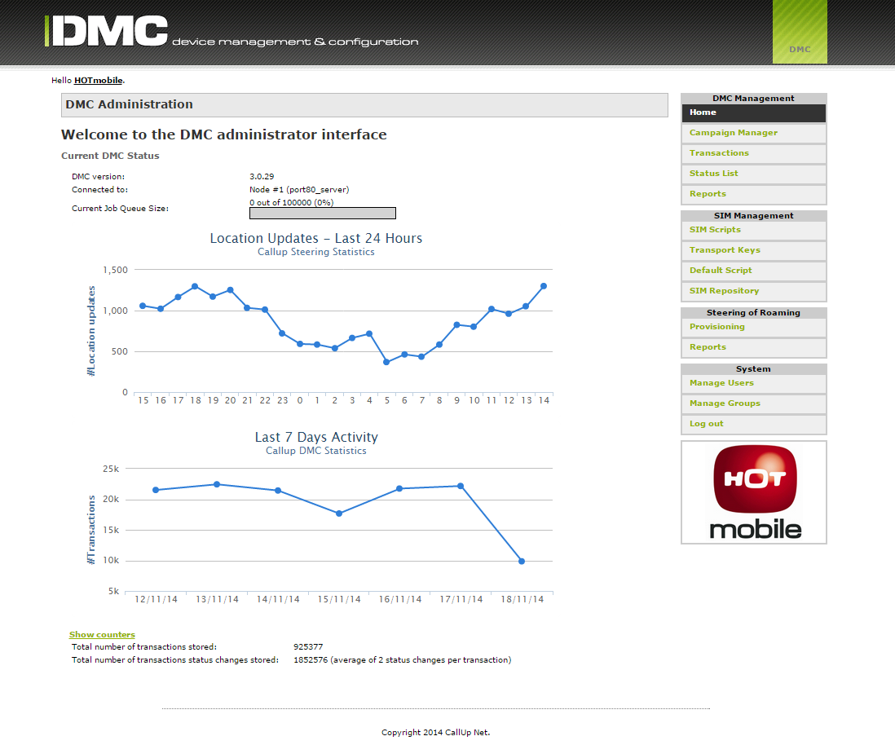
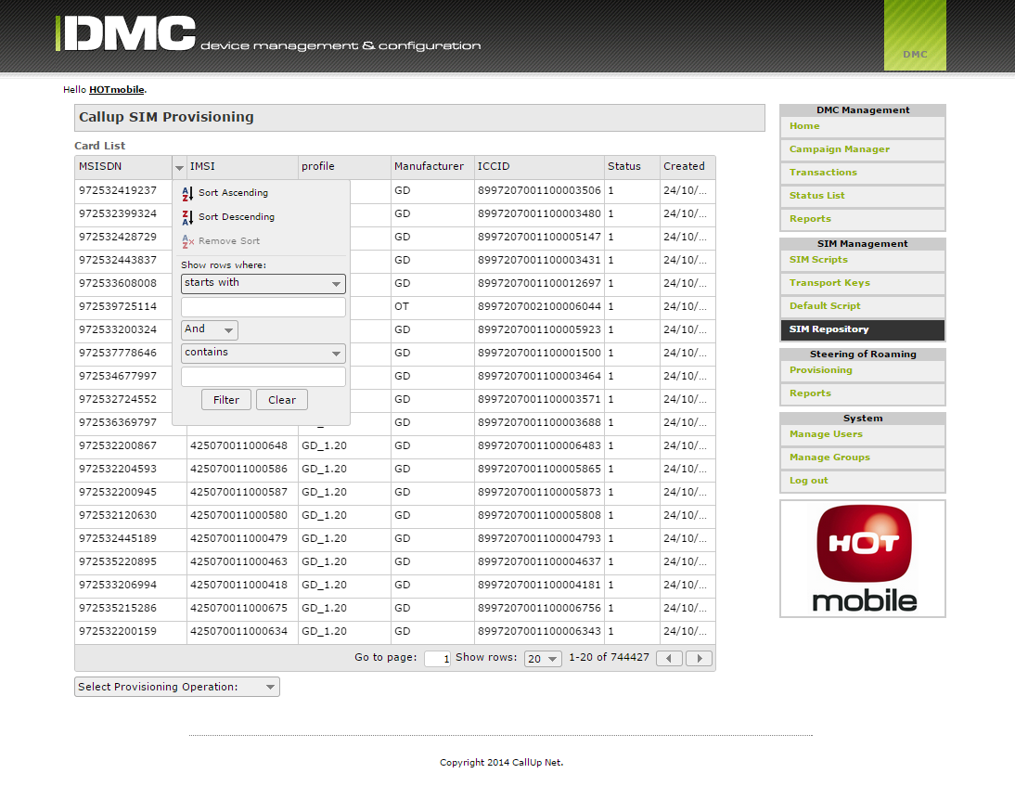
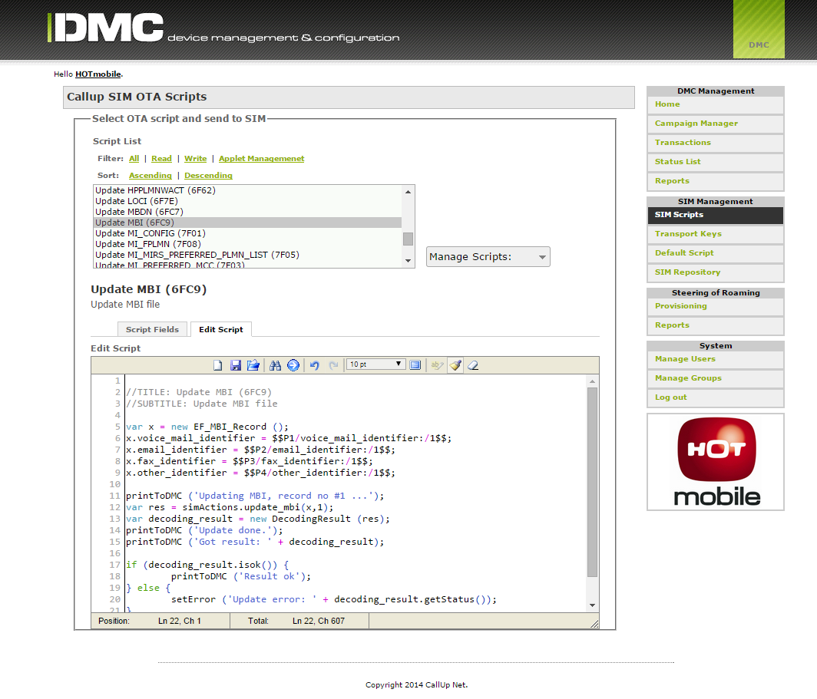
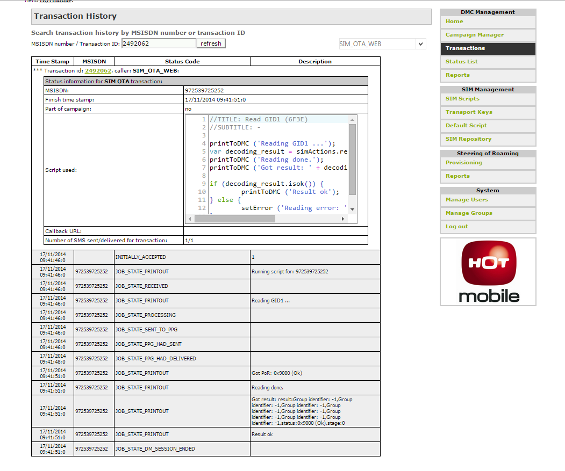
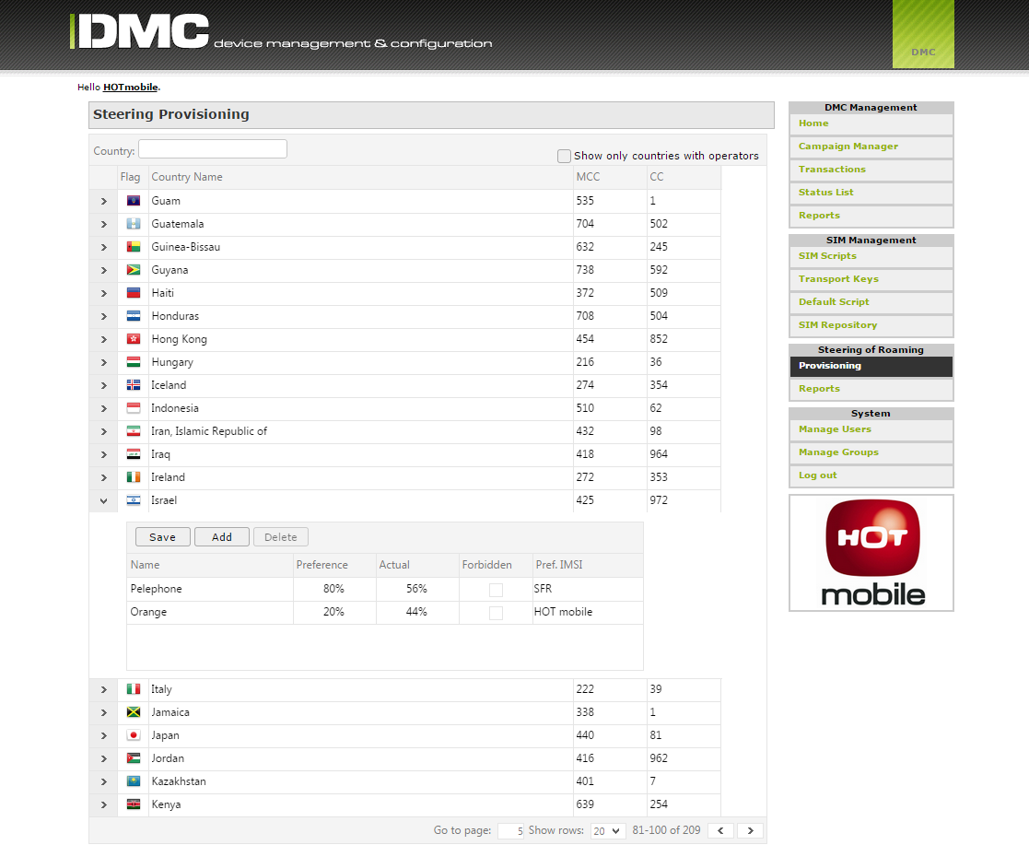
A Glance at the User Interface
OTA Dashboard
Card Provisioning
SIM Services (Scripts)
Read file from SIM
Steering Provisioning

Slide 19
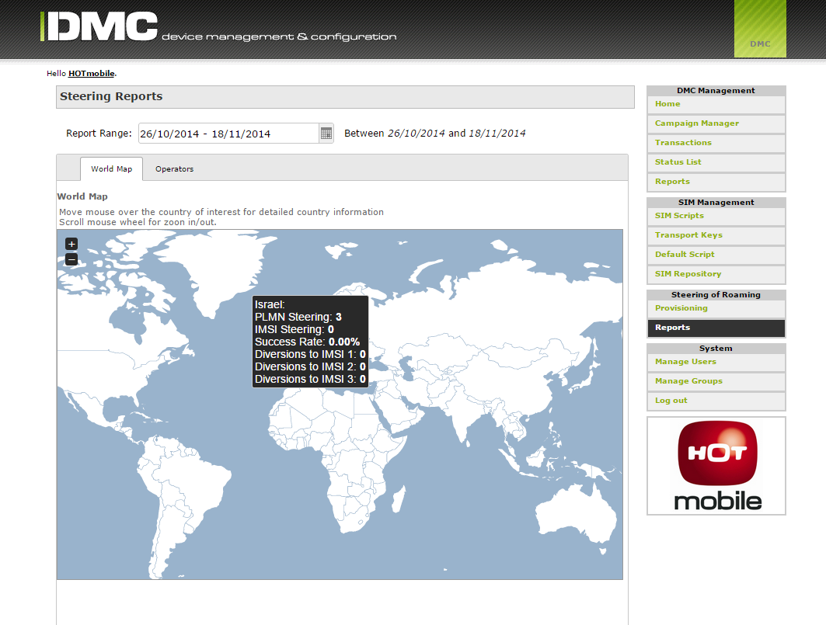
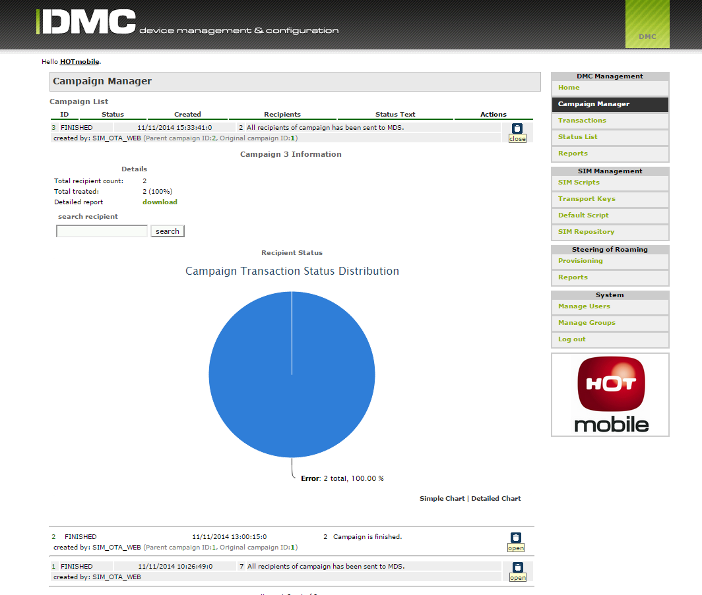
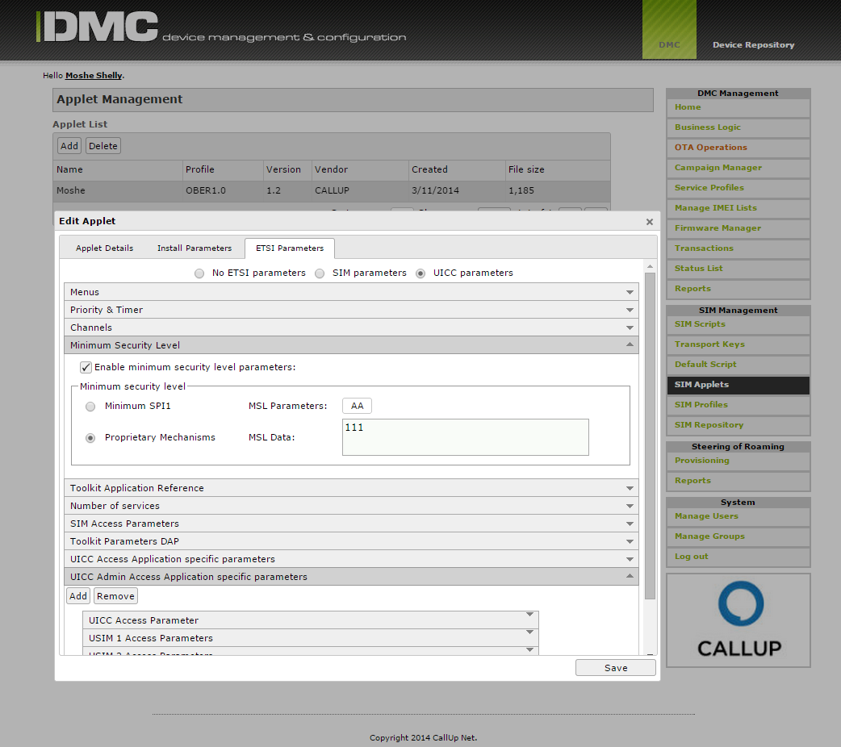
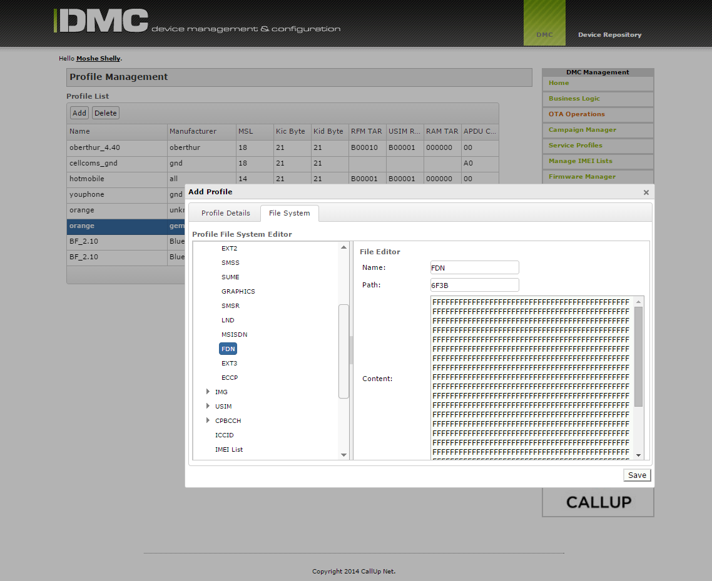
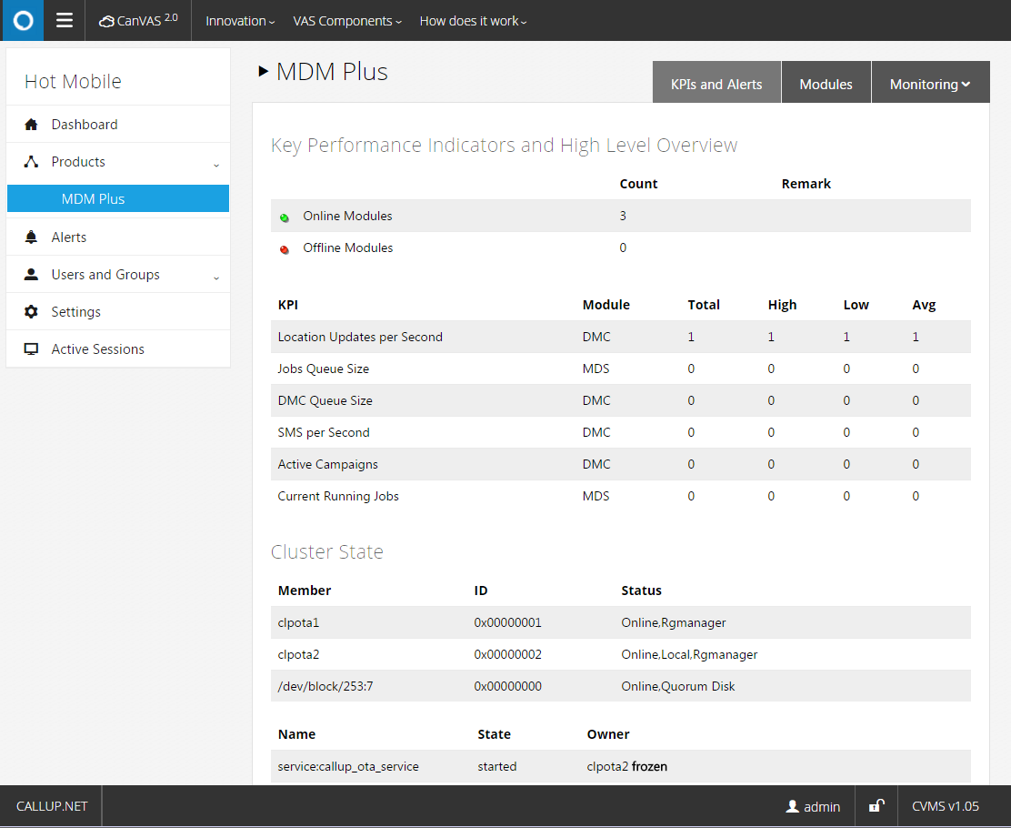
Select Reports
Steering Reports
Campaign Reports
Applet Management
Profile Management
CVMS KPIs

Slide 20
Platform Overview
Tech Info
Timeline
Customers

Slide 21
SIM OTA – 12-Month Roadmap
VERSION 3.0
MVNO network control service for MVNOs, enables controlling agreements with MNOs and subscriber/card dispersion
GUI-built dynamic queries for reports and campaign recipient-list generation
Fine-tuned applet management as part of card profiles
VERSION 3.1.0
NFC TSM – Solution for 3rd party access to OTA functionalities
Dynamic SIM – Auto deletes expired cards for license efficiency
VERSION 3.2.0
Lawful interception location service – Tracks users on google maps GUI, with harsh security and provisioning systems
VERSION 4.0
M2M solution designed for M2M, dynamic on-the-fly activation, generic (white label) card profile support
Q2 2016
Q3 2016
Q4 2016
2017
Notes:
NFC:
NFC TSM (Trusted Security Manager) – something that should be in an OTA system. We need to provide the means for and operator to enable NFC applications, basically this is a broker for 3rd party bodies (for example banks, credit cards, bus companies) – to access the OTA platform in a secure way, from one central managed system. It includes:
End to end security
Specified web services to do pre-defined task (i.e. enable/disable of services)
Application lifecycle management
Key management
M2M:
We might need to think of the M2M aspects as part of the OTA platform, but not just for SIM cards necessarily, but about the whole thing. This is a more general thing and might be out of OTA scope, but completion does mention M2M as part of their capabilities.
Third idea – is mine, not from market/completion, Dynamic SIM:
What do you think about doing something like Dynamic mailbox here – Dynamic SIM. If a card was not active for X months, it will be automatically deleted, and will not be counted for licensing purposes. The difference is that a card cannot be generated automatically (like a mailbox) – since cards must be pre-provisioned in order for the OTA platform to be able to speak with them. Still, such “auto-delete” policy might be appealing for customers, takes some of the management pressure of their IT guys.
Other ideas worth remembering when talking about OTA features: On-Demand activation (like Joaquin always talks in Latin America), MNO control for MVNOs etc.

Slide 22
Delivery Lifecycle Milestones
PO - Kickoff
Project customizations,
site readiness for integration,
HW shipment,
physical installation,
VPN to site
Acceptance
ATP
Training
Planning
Detailed design approval by customer
Network detailed design
Project plan
Commercial launch
Deployment
installation / integration
Handover to support

Slide 23
Platform Overview
Tech Info
Timeline
Customers

Slide 24
Select Customers
CUSTOMER | COUNTRY | SIZE | PRODUCTS
EUROPEAN CARRIER | --- | 11M+ | MDM+
LATAM CARRIER* | Chile | 5M | MDM+
IUSACELL | Mexico | 16M | MDM+ (Voicemail, WHC/NFM, SMSC, MDM+)
HOT MOBILE | Israel | 1M | MDM+ (BMS, SMSC, USSD,MDM+)
MAKEDONSKI TELEKOM | Macedonia | 0.5M | CanVAS (Voicemail) for fixed network
MTS | India | 20M | MDM+
EFFORTEL | Belgium, France, Italy, Taiwan | 1M | CanVAS (Voicemail, WHC/NFM)
PELEPHONE | Israel | 3M | MDM+ (MMSC, BMS, MDM+)
CELLCOM | Israel | 3M | CanVAS (MMSC, BMS)
MTN | Nigeria | 20M | USSD Callback
KYIVSTAR | Ukraine | 25M | IVR + Songmatcher
ORANGE | Dominican Republic | 0.5M | MDM+ (MMSC, MDM+, SMSC)
GOLAN TELECOM | Israel | 0.5M | CanVAS (SMSC, MMSC, Voicemail, WHC/NFM, BMS)
YOUPHONE | Israel | 100K | MDM+ (SMSC, MDM+)
* In process

Slide 25
Case Studies
Mexico's 3rd largest wireless telecommunications operator.
Over 10 million subscribers (67% prepaid)
CallUp’s Advanced Voicemail
Solution
Large device management and voicemail system, distributed over 12 sites
Including MDM+,IVR, SIP, DB, CVMS
On-site maintenance and support
Israel’s 4th largest MNO.
~1 million subscribers, with various card manufacturers and a complex environment.
Custom Tailored Fast Delivery
System delivered in a few months with all adaptations.
All interfaces maintained.
Gemalto DB kept updated in parallel (forking)
4G-card ready
Steering (Full+MI)
Indian CDMA operator, 10-15M subscribers
Unique Over the Air Solution
OTAF solution, based on Over-the-Air Service Provisioning for activation of devices over the air, Over-the-Air-Parameter Administration for updating parameters in devices over the air, *228 and IVR.

Slide 26
Thank You
All rights reserved Callup © 2013 | www.callup.net | Facebook | Twitter | Linkedin

